Slide 1
The STANFORD GROUNDWATER ARCHITECTURE PROJECT (GAP)
Utilizing Advanced Geophysical and Computational Methods
for the Development of Hydrogeologic Conceptual Models
Project Leads:
Rosemary Knight (Stanford)
Max Halkjær (Ramboll)
Niels-Peter Jensen (I-GIS)
Esben Auken (Aarhus University)
Jim Cannia (Aqua Geo Frameworks)

Slide 2
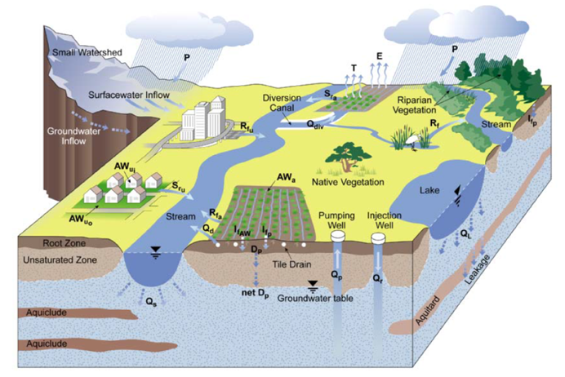
Sustainable Groundwater Management Act (SGMA, 2014)
A hydrogeologic conceptual model is required. (GSP Regulation §354.14)
This model should have the detail required to accurately simulate the response of the groundwater system - present and future.
CA Dept of Water Resources
Notes:
Decision-making for groundwater management typically starts with a conceptual model such as this.
Quantitative modelling, to support decision making is done by transforming a conceptual model

Slide 3
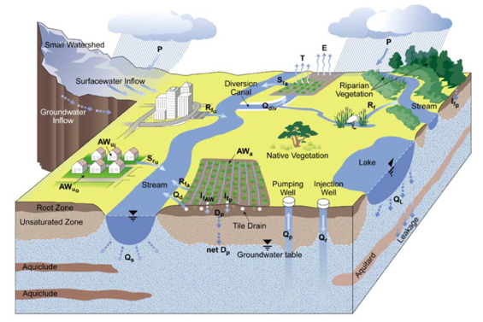
Our Vision:
use of the Airborne Electromagnetic Method to acquire data needed to develop the conceptual model
30 m (100 ft) above the ground
80 km/hr (50 mph)
?
250-350 km (150-220 miles) flown in a day
Notes:
Mary Scrugs DWR

Slide 4
The use of AEM data in the development of the hydrogeologic conceptual model:
Developing the optimal workflow
How to do this throughout California?
?
Notes:
Mary Scrugs DWR

Slide 5
Groundwater Architecture Project: 2018-2020
Three pilot studies to develop the optimal workflow for the use of AEM data in the development of the hydrogeologic conceptual model.
Project Leads:
Rosemary Knight (Stanford)
Max Halkjær (Ramboll)
Niels-Peter Jensen (I-GIS)
Esben Auken (Aarhus University)
Jim Cannia (Aqua Geo Frameworks)
Project Partners:
Butte Cty Dept of Water & Resource Conservation: Paul Gosselin, Christina Buck
Indian Wells Valley Water District: Don Zdeba
San Luis Obispo Cty: Catherine Martin, Ray Dienzo
Funding:
Local agencies
California Dept of Water Resources, State Water Resources Control Board
Danish EPA

Slide 6
GAP Workflow
1) Engage with local agency to identify groundwater management questions
2) Develop the Data Management System
3) Compile existing data
4) Design the AEM survey
5) Acquire the AEM data
6) Analyze the AEM data to obtain the resistivity model
7) Interpret the resistivity models to extract the needed information
8) Integrate all data to generate the conceptual model
9) Answer the management questions, acknowledging uncertainty.

Slide 7
GAP Workflow
1) Engage with local agency to identify groundwater management questions
2) Develop the Data Management System
3) Compile existing data
4) Design the AEM survey
5) Acquire the AEM data
6) Analyze the AEM data to obtain the resistivity model
7) Interpret the resistivity models to extract the needed information
8) Integrate all data to generate the conceptual model
9) Answer the management questions, acknowledging uncertainty.

Slide 8
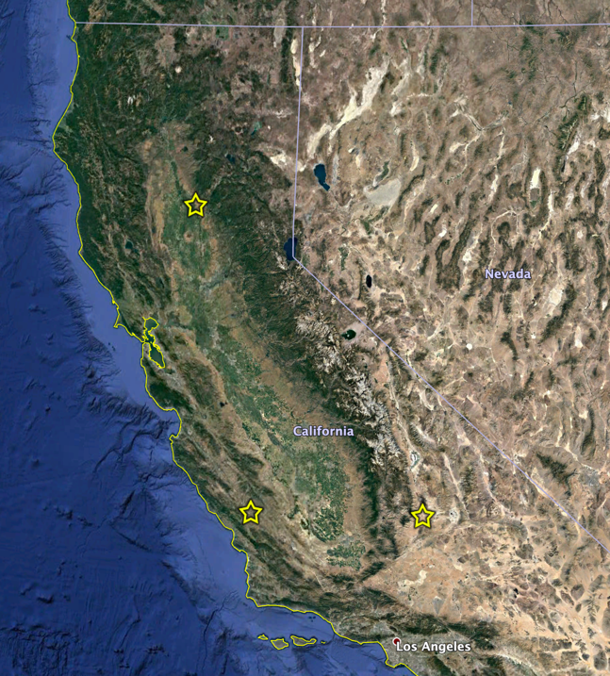
Local Agency Partners
Butte/Glenn Counties
Paul Gosselin Christina Buck
San Luis Obispo County
Catherine Martin
Indian Wells Valley
Don Zdeba
Notes:
Option 2

Slide 9
“Decision-Aware Geophysics”
What are the groundwater management decisions that need to be addressed?
This guides every step of the workflow.

Slide 10
Examples of Groundwater Management Questions
from Butte/Glenn Counties
Characterization of stratigraphy and aquifer architecture.
Delineate the architecture of the major aquifers and aquitards
Examine the level of connectivity between the upper and lower portions of the Tuscan/Tehama aquifer system.
Assess the spatial distribution and quantity of clay-rich sediments, providing an estimate of possible subsidence risk.
Identify areas that need to be grouped into hydrostratigraphic layers.

Slide 11
Examples of Groundwater Management Questions
from Butte/Glenn Counties
2) Mapping of the water table
3) Investigation of the transition from fresh to saline water at depth where the depth to saline groundwater is sufficiently shallow.
4) Coordination across groundwater basin boundaries to assess groundwater-surface water interaction.
5) Optimize groundwater management efforts.
Identify areas for new monitoring well installation.
Identify areas for managed aquifer recharge projects.

Slide 12
GAP Workflow
1) Engage with local agency to identify groundwater management questions
2) Develop the Data Management System
3) Compile existing data
4) Design the AEM survey
5) Acquire the AEM data
6) Analyze the AEM data to obtain the resistivity model
7) Interpret the resistivity models to extract the needed information
8) Integrate all data to generate the conceptual model
9) Answer the management questions, acknowledging uncertainty.

Slide 13
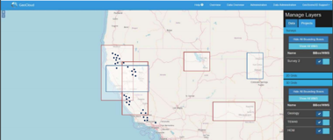
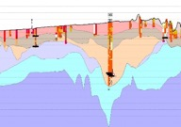
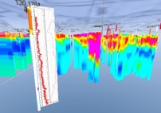
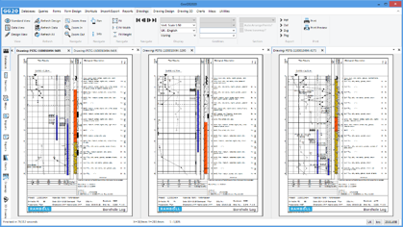
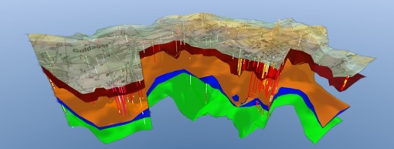
What is GeoSuite?
GeoSuite is a web-based georeferenced relational data management system (DMS) developed for California by I-GIS
Provided by Niels-Peter Jensen, IGIS

Slide 14
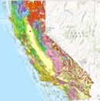

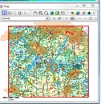
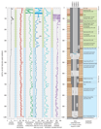
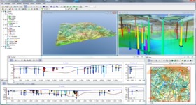
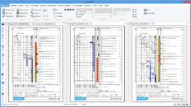
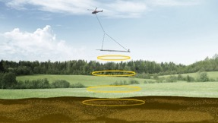



GeoSuite DMS
Provided by Niels-Peter Jensen, IGIS
Geology
GIS Web-viewer
Well logs
HCM and GSP
Geophysics
Full support service
Provided by Niels-Peter Jensen, IGIS

Slide 15
GAP Workflow
1) Engage with local agency to identify groundwater management questions
2) Develop the Data Management System
3) Compile existing data
4) Design the AEM survey
5) Acquire the AEM data
6) Analyze the AEM data to obtain the resistivity model
7) Interpret the resistivity models to extract the needed information
8) Integrate all data to generate the conceptual model
9) Answer the management questions, acknowledging uncertainty.

Slide 16
GAP Workflow
3) Compile existing data
Gather, organize, and digitize sufficient data to support acquisition, analysis and interpretation of AEM data.
lithology logs
geophysical logs
water quality data
geologic/hydrogeologic cross-sections
water table measurements

Slide 17
GAP Workflow
1) Engage with local agency to identify groundwater management questions
2) Develop the Data Management System
3) Compile existing data
4) Design the AEM survey
5) Acquire the AEM data
6) Analyze the AEM data to obtain the resistivity model
7) Interpret the resistivity models to extract the needed information
8) Integrate all data to generate the conceptual model
9) Answer the management questions, acknowledging uncertainty.

Slide 18
Done in close consultation with local agency to ensure that the designed survey can acquire the data needed to answer identified groundwater management questions.
1) Start with existing data (well data + other).
2) Review (develop as needed) model/s of the system – determine areas of uncertainty due to lack of data.
3) Formal or informal sensitivity analysis: assess sensitivity of answers to management questions to new data; guides consideration of if/where to acquire more data.
4) Forward model the geophysics to assess ability to resolve key features, likely depth of imaging, anticipated quality of data, etc..
5) Finalize flight line planning.
Notes:
Using sensors on the ground surface, deployed on airborne or satellite platforms.

Slide 19
GAP Workflow
1) Engage with local agency to identify groundwater management questions
2) Develop the Data Management System
3) Compile existing data
4) Design the AEM survey
5) Acquire the AEM data
6) Analyze the AEM data to obtain the resistivity model
7) Interpret the resistivity models to extract the needed information
8) Integrate all data to generate the conceptual model
9) Answer the management questions, acknowledging uncertainty.

Slide 20
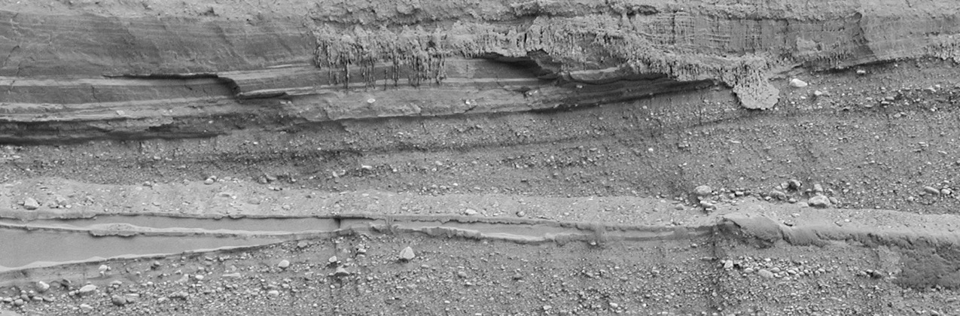
Current flows around transmitter loop
Notes:
Transmitter loop

Slide 21
Current flows around transmitter loop
Primary magnetic field generated

Slide 22
Current flows around transmitter loop
depth depends on electrical resistivity
Primary magnetic field generated
Eddy currents
induced in the ground
Notes:
termination of current causes a time-varying decay in the magnetic field which causes eddy currents to flow at various depths in beneath the surface of the ground

Slide 23
Current flows around loop
Secondary magnetic field
detected by receiver coils
Primary magnetic field generated
Eddy currents
induced in the ground

Slide 24
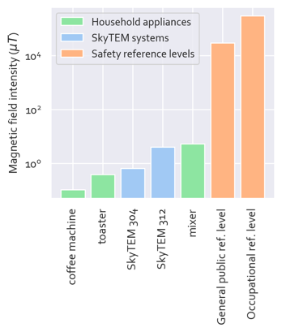
Materials are available on our website (mapwater.stanford.edu) that can be used to notify the public about upcoming AEM data acquisition.
The following plot compares the electromagnetic field intensity associated with a SkyTEM survey to that of common appliances (at a distance of ~1 ft away) and reference safety levels.
Graphic prepared by Ian Gottschalk (Stanford University, 2019) based on information from:
Gisselø, P. (2013). Transmitted field frequency content . Memo to SkyTEM Surveys ApS, Aarhus, Denmark.
International Commission on Non-Ionizing Radiation Protection. (2010). Guidelines for limiting exposure to time-varying electric and magnetic fields (1 Hz to 100 kHz). Health physics, 99(6), 818-836.
Long Island Power Authority. (2005). Magnetic Field Levels around the Home [Brochure]. Retrieved from http://ehs.ucsd.edu/LBCI/LIPA_Magnetic_Field_Levels_Around_Homes.pdf
Notes:
Ian to fix key.

Slide 25
GAP Workflow
1) Engage with local agency to identify groundwater management questions
2) Develop the Data Management System
3) Compile existing data
4) Design the AEM survey
5) Acquire the AEM data
6) Analyze the AEM data to obtain the resistivity model
7) Interpret the resistivity models to extract the needed information
8) Integrate all data to generate the conceptual model
9) Answer the management questions, acknowledging uncertainty.

Slide 26

What is obtained from processing and
analysis of the AEM data -
ρ
Electrical Resistivity Model
horizontal resolution: 60 m
vertical resolution: ~3 m (10 ft) at surface increasing to ~ 50 m (160 ft) at 500 m
ρ
ρ
ρ
ρ
ρ
ρ
ρ
ρ
ρ
ρ
ρ
ρ
ρ
ρ
ρ
ρ
ρ
ρ
ρ
ρ
ρ
ρ
ρ
ρ
ρ
ρ
ρ
ρ
ρ
ρ
ρ
ρ
ρ
ρ
ρ
ρ
ρ
ρ
ρ
ρ
ρ
ρ
ρ
ρ
ρ
ρ
ρ
ρ
ρ
ρ
ρ
ρ
ρ
ρ
ρ
ρ
ρ
ρ
ρ
ρ
ρ
ρ
ρ
ρ
ρ
ρ
ρ
ρ
ρ
ρ
ρ
ρ
ρ
ρ
ρ
ρ
ρ
ρ
ρ
ρ
ρ
ρ
ρ
ρ
ρ
ρ
ρ
ρ
ρ
ρ
ρ
ρ
ρ
ρ
ρ
ρ
ρ
ρ
ρ
ρ
Notes:
Transmitter loop

Slide 27
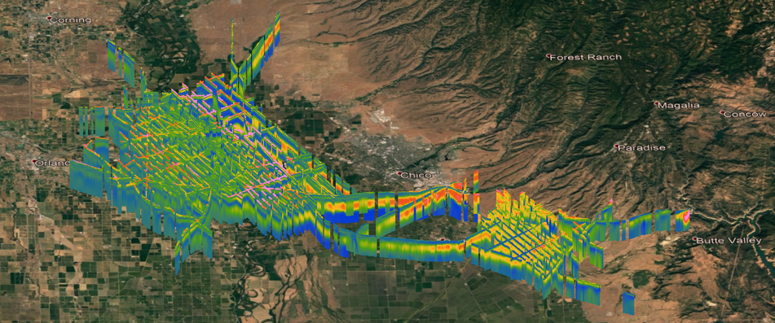
3D Resistivity Model from Butte County
SkyTEM data – 800 line km acquired December 2018
Processed/Inverted by Aqua Geo Frameworks
Warm colors (reds) correspond to the presence of sands and gravel; cool colors (blues) to clay-rich packages.
30 km
45 km
Leapfrog software provided by Seequent
Depth of Investigation:
eastern area (SkyTEM 312): 236 m - 338 m
western area (SkyTEM 304): 196 m - 321 m
Resolution: horizontal, ~ 60 m along flight lines; vertical, meters to 10s of meters

Slide 28
GAP Workflow
1) Engage with local agency to identify groundwater management questions
2) Develop the Data Management System
3) Compile existing data
4) Design the AEM survey
5) Acquire the AEM data
6) Analyze the AEM data to obtain the resistivity model
7) Interpret the resistivity models to extract the needed information
8) Integrate all data to generate the conceptual model
9) Answer the management questions, acknowledging uncertainty.

Slide 29
Use Lithology Logs
+
ρ
Electrical Resistivity Model
sediment texture
Notes:
Transmitter loop

Slide 30
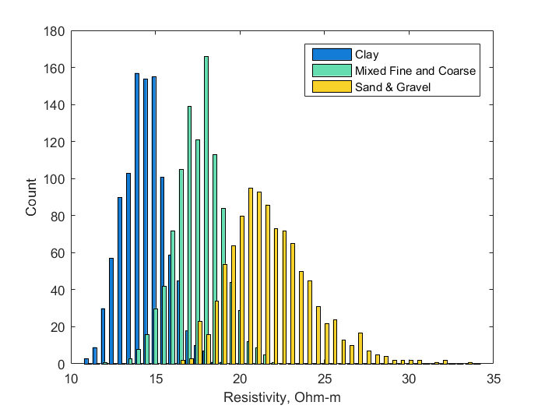
Example from Tulare Irrigation District
Knight, Smith, Asch, Abraham, Cannia, Viezzoli, Fogg, Groundwater, 2018
MIXED
CLAY
The Link Between Resistivity and Lithology
SAND & GRAVEL
Notes:
Seogi from Butte

Slide 31
Example from Tulare Irrigation District
Knight, Smith, Asch, Abraham, Cannia, Viezzoli, Fogg, Groundwater, 2018
MIXED
CLAY
Interpret & Use the Most Probable Lithology
SAND & GRAVEL
Notes:
Seogi from Butte

Slide 32
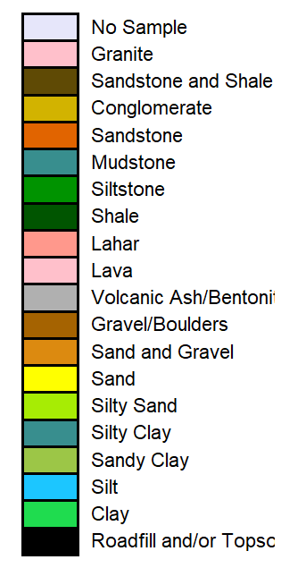




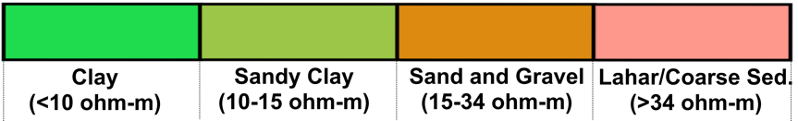
Example from Butte and Glenn Counties
Stratigraphy &
Lithology
Quaternary
Quaternary
Tehama Formation
Tuscan Formation
Lovejoy Basalt
Upper Princeton Valley Fill, Ione Formation, Lower Princeton Valley Fill, and Great Valley Sequence undivided
Metamorphic and Igneous Rocks
Tertiary
JKTud
Cretaceous
Jurassic

Slide 33
GAP Workflow
1) Engage with local agency to identify groundwater management questions
2) Develop the Data Management System
3) Compile existing data
4) Design the AEM survey
5) Acquire the AEM data
6) Analyze the AEM data to obtain the resistivity model
7) Interpret the resistivity models to extract the needed information
8) Integrate all data to generate the conceptual model
9) Answer the management questions, acknowledging uncertainty.

Slide 34
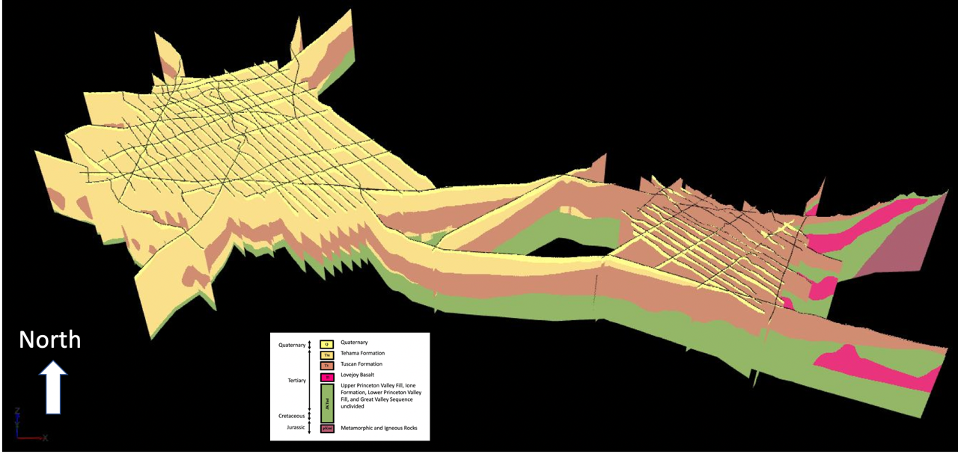
Butte/Glenn Counties 3D View Hydrogeologic Units- Looking North
Example from Butte and Glenn Counties
Quaternary
Tehama Fm
Tuscan Fm
undivided units
Lovejoy Basalt

Slide 35

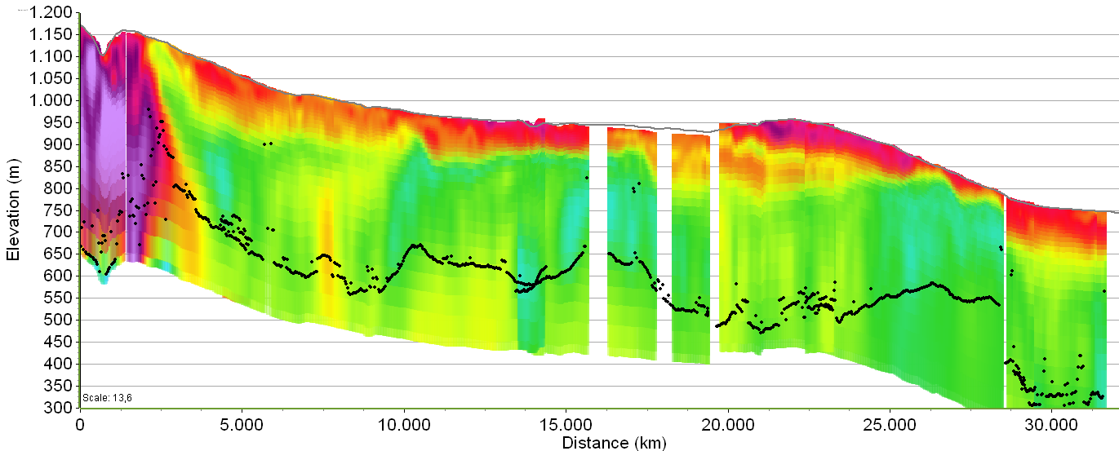
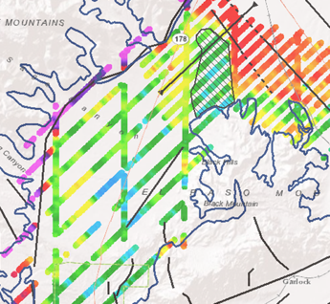

Example from Indian Wells Valley:
Interpretation of Structures and Lithology
Saturated
Unsaturated
Bed
rock
Sierra Nevada
Frontal Fault
Brackish
Clay
Sand and gravel
Potential infiltration sites
Bed rock
Pleistocene Alluvium
Miocene Ricardo Group.
Hydrological barrier
dividing the groundwater
basin
DOI
Notes:
Basin delineation to the SW
Mapping faults controlling the flow, creating sub-basins and dividing the overall groundwater basin
Even though the flight line spacing is sparse it gives us the first impression on where water can be infiltrated and how it can be stored.

Slide 36
GAP Workflow
1) Engage with local agency to identify groundwater management questions
2) Develop the Data Management System
3) Compile existing data
4) Design the AEM survey
5) Acquire the AEM data
6) Analyze the AEM data to obtain the resistivity model
7) Interpret the resistivity models to extract the needed information
8) Integrate all data to generate the conceptual model
9) Answer the management questions, acknowledging uncertainty.

Slide 37
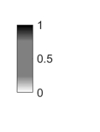
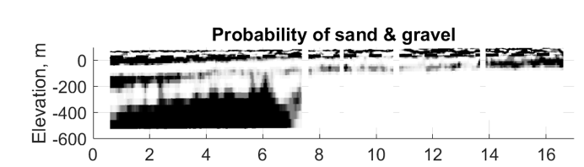
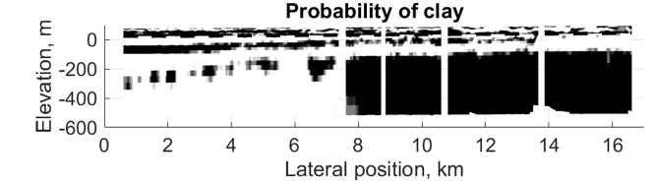
Interpretation in Probabilistic Framework to Quantify Uncertainty
Display as Probabilities
Darker = more probable
Well Data
lithology
resistivity
AEM Data
InversionS
Resistivity Model
Resistivity Model
Resistivity Model
Resistivity ModelS
resistivity-to-lithology transformS
Lithology Model
Lithology Model
Lithology Model
CLAY
Lithology ModelS

Slide 38
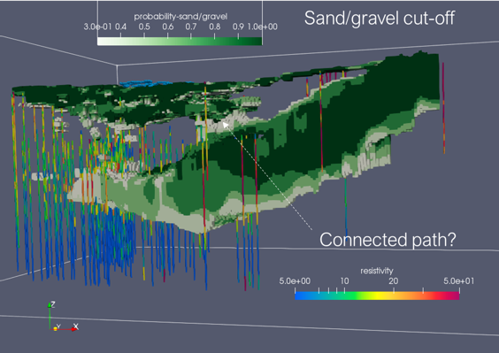
Use Probabilities of the Presence of a Lithologic Unit to Answer Questions
Example: What is the connectivity between the upper and the lower aquifer?
~30 km
Upper Aquifer
Probability of Sand/Gravel
(darker = more probable)
What is in here?
Lower Aquifer
500 m
~50 km
Low probability of sand/gravel so there is a low level of probability that the upper and lower aquifers are connected.
Notes:
Left – apply cutoff to best model
Right – bring in all models – 5

Slide 39
Airborne Electromagnetic Method
?
Our vision: The use of AEM data as an integral part of building groundwater models throughout California.

